Slide 1
University physics, classical mechanics, Lecture 7. Still Lesson 6: Momentum and impulse
Teacher: Dr. Paul Briard
Wechat: Paulbg123

Slide 2


Mass changing problems
The concept of momentum permits also to describe problems where the mass of the body considered is changing,
Take care that the Newton’s second law as
$$m\frac{d\vec{v}}{dt}=\vec{F}$$
$$\frac{dm}{dt}=0$$
is valid if
(i.e. the mass is constant)
Notes:
PARLER LENTEMENT: Before to speak about the next lesson, I want to give more details about problems where the mass of the body studied is changed. I have spoken about it a bit when I introduced the concept of momentum. The Newton second law as given here is only valid when the mass of the body don’t change with time.

Slide 3




Mass changing problems
The concept of momentum permits also to describe problems where the mass of the body considered is changing,
Take care that the Newton’s second law as
$$m\frac{d\vec{v}}{dt}=\vec{F}$$
$$\frac{dm}{dt}=0$$
is valid if
(i.e. the mass is constant)
If $\frac{dm}{dt}≠0$, it is necessary to use
$$\frac{d\vec{p}}{dt}=\vec{F}$$
$$\frac{d(m\vec{v})}{dt}=\vec{F}$$
$$m\frac{d\vec{v}}{dt}+\vec{v}\frac{dm}{dt}=\vec{F}$$
Notes:
PARLER LENTEMENT: But considering the mass could change with time, we have to consider the Newton second law applied to the momentum. The change rate of the momentum is the net force exerted on the body.

Slide 4
Mass changing problems
The concept of momentum permits also to describe problems where the mass of the body considered is changing,
Take care that the Newton’s second law as
$$m\frac{d\vec{v}}{dt}=\vec{F}$$
$$\frac{dm}{dt}=0$$
is valid if
(i.e. the mass is constant)
If $\frac{dm}{dt}≠0$, it is necessary to use
$$\frac{d\vec{p}}{dt}=\vec{F}$$
$$\frac{d(m\vec{v})}{dt}=\vec{F}$$
$$m\frac{d\vec{v}}{dt}+\vec{v}\frac{dm}{dt}=\vec{F}$$
Notes:
PARLER LENTEMENT: And in that case, we have to include in the Newton second law a term which is the velocity vector of the body, multipied by the change rate of its mass.

Slide 5
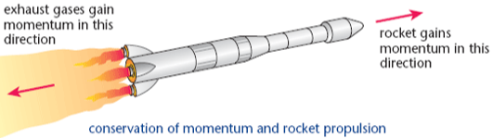
Rocket propulsion
We consider a rocket propagating in outer space (no gravity considered)
$$x$$
At the time $t_{0}$, the mass of the rocket is $m_{0}$, its velocity is $v_{0}$ in our reference frame (us who are watching the rocket)
Notes:
PARLER LENTEMENT: Now let’s to consider a rocket which advance toward the the +x-direction. The rocket gains momentum in the +x-direction, The rocket exhausts gases which get momentum in the opposite direction. At the time t zero, the mass of the rocket is m zero and its velocity is v0. We consider the rocket moves outer space, which means we don’t consider gravitational forces exerted on it. The net force exerted is here zero.

Slide 6
Rocket propulsion
We consider a rocket propagating in outer space (no gravity considered)
$$x$$
At the time $t_{0}$, the mass of the rocket is $m_{0}$, its velocity is $v_{0}$ in our reference frame (us who are watching the rocket)
At any time $t>t_{0}$, the mass of the rocket is $m\left(t\right)<m_{0}$, its velocity is $v(t)$
Notes:
PARLER LENTEMENT: At a time greater than t zero, the mass of the rocket as decreased. Its mass is smaller than m zero. And its velocity v is our frame of reference, I means us who are watching this rocket from us.

Slide 7
Rocket propulsion
We consider a rocket propagating in outer space (no gravity considered)
$$x$$
At the time $t_{0}$, the mass of the rocket is $m_{0}$, its velocity is $v_{0}$ in our reference frame (us who are watching the rocket)
At any time $t>t_{0}$, the mass of the rocket is $m\left(t\right)<m_{0}$, its velocity is $v(t)$
During a time interval $dt$ the mass of rockets change is $dm$ corresponding to the mass of the burned fuel.
Notes:
PARLER LENTEMENT: During an infinitesimal time interval dt, the Rocket as a infinitesimal change of mass dm corresponding to the burned fuel.

Slide 8

Rocket propulsion
We consider a rocket propagating in outer space (no gravity considered)
$$x$$
At the time $t_{0}$, the mass of the rocket is $m_{0}$, its velocity is $v_{0}$ in our reference frame (us who are watching the rocket)
At any time $t>t_{0}$, the mass of the rocket is $m\left(t\right)<m_{0}$, its velocity is $v(t)$
During a time interval $dt$ the mass of rockets change is $dm$ corresponding to the mass of the burned fuel.
The x-velocity of the burned fuel in our frame of reference is:
$$v_{fuel,x}=v_{x}\left(t\right)−v_{ex}$$
where $v_{ex}$ is the velocity of the burned fuel relative to the rocket.
Notes:
PARLER LENTEMENT: And we can describe the x-component of the velocity of the fuel in respect with our frame of reference, it is the velocity of the rocket in respect with our frame of reference minus the x-velocity of the fuel in respect with the rocket. This velocity is constant with time. To better understand what happens, imagine this velocity v_ex is almost zero, the burned fuel stays close to zero. In that case, the x-velocity of the burned fuel in our frame of reference is has same value that the x-velocity of the rocket. If v_ex is smaller that v_x, the burned fuel don’t stays close to the rocket but have a motion toward the +-x-direction, as for the rocket. If v_ex is greater than v_x, the x-velocity of the fuel in our frame of reference is negative, the burned fuel moves toward the –x-direction while the rocket moves toward the +x-direction.

Slide 9
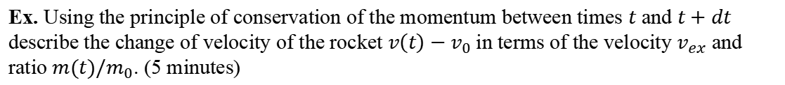
Rocket propulsion
We consider a rocket propagating in outer space (no gravity considered)
$$x$$
At the time $t_{0}$, the mass of the rocket is $m_{0}$, its velocity is $v_{0}$ in our reference frame (us who are watching the rocket)
At any time $t>t_{0}$, the mass of the rocket is $m\left(t\right)<m_{0}$, its velocity is $v(t)$
During a time interval $dt$ the mass of rockets change is $dm$ corresponding to the mass of the burned fuel.
The x-velocity of the burned fuel in our frame of reference is:
$$v_{fuel,x}=v_{x}\left(t\right)−v_{ex}$$
where $v_{ex}$ is the velocity of the burned fuel relative to the rocket.
Ex. Using the principle of conservation of the momentum between times $t$ and $t+dt$ describe the change of velocity of the rocket $v\left(t\right)−v_{0}$in terms of the velocity $v_{ex}$ and ratio $m(t)/m_{0}$. (5 minutes)
Notes:
PARLER LENTEMENT: And as for the cases of collisions we have seen last time, we consider there are no external forces exerted on the system rocket+fuel, so there is conservation of momentum of this system. By using the principle of conservation of momentum and the Newton second law, please to describe the change of velocity of the rocket in terms of the ratio between the mass of the rocket at time t and its initial mass zero.

Slide 10
Rocket propulsion
We consider a rocket propagating in outer space (no gravity considered)
$$x$$
Warning: the momentum of any body depends to the reference frame chosen. The reference frame chosen must be the same for all bodies when we apply the principle of conservation of momentum.
Notes:
PARLER LENTEMENT: Take care that the momentum of any body depends to the reference frame chosen. The reference frame chosen must be the same for all bodies when we apply the principle of conservation of momentum. Let’s see the solution.

Slide 11



Rocket propulsion
We consider a rocket propagating in outer space (no gravity considered)
$$x$$
Warning: the momentum of any body depends to the reference frame chosen. The reference frame chosen must be the same for all bodies when we apply the principle of conservation of momentum.
Momentum of the rocket at time $t$:
$$\vec{p}(t)=m(t)\vec{v}(t)$$
$x$-component:
$$p_{x}(t)=m(t)v_{x}(t)$$
Notes:
PARLER LENTEMENT: First we I describe the momentum of the rocket, it is its mass multiplied by its velocity vector in our reference frame. We can also describe the x-component of its momentum as follows.

Slide 12
Rocket propulsion
We consider a rocket propagating in outer space (no gravity considered)
$$x$$
Warning: the momentum of any body depends to the reference frame chosen. The reference frame chosen must be the same for all bodies when we apply the principle of conservation of momentum.
Momentum of the rocket at time $t$:
$$\vec{p}(t)=m(t)\vec{v}(t)$$
$x$-component:
$$p_{x}(t)=m(t)v_{x}(t)$$
$x$-component of momentum of the rocket at time $t+dt$:
$$p_{x}\left(t+dt\right)=\left(m\left(t\right)+dm\right)(v_{x}(t)+dv)$$
Notes:
PARLER LENTEMENT: And we can describe the x-component of the momentum at time t+dt as follows. It is the mass of the rocket at time t+dt, so m + dm multiplied by the velocity of the rocket at time t+dt, so the x-velocity of the rocket at time t + an infinitesimal change of velocity.

Slide 13

Rocket propulsion
We consider a rocket propagating in outer space (no gravity considered)
$$x$$
Warning: the momentum of any body depends to the reference frame chosen. The reference frame chosen must be the same for all bodies when we apply the principle of conservation of momentum.
Momentum of the rocket at time $t$:
$$\vec{p}(t)=m(t)\vec{v}(t)$$
$x$-component:
$$p_{x}(t)=m(t)v_{x}(t)$$
$x$-component of momentum of the rocket at time $t+dt$:
$$p_{x}\left(t+dt\right)=\left(m\left(t\right)+dm\right)(v_{x}(t)+dv)$$
$x$-component of momentum of burned fuel (between times$t$and $t+dt$):
$$p_{fuel,x}=−dm v_{fuel,x}$$
Notes:
PARLER LENTEMENT: We can also describe the momentum of the burned fuel, which correspond to the mass dm lost by the rocket between times t and t+dt, and multiplied by its velocity.

Slide 14

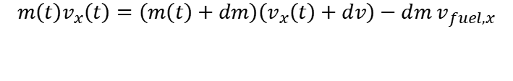
Rocket propulsion
We consider a rocket propagating in outer space (no gravity considered)
$$x$$
Warning: the momentum of any body depends to the reference frame chosen. The reference frame chosen must be the same for all bodies when we apply the principle of conservation of momentum.
Momentum of the rocket at time $t$:
$$\vec{p}(t)=m(t)\vec{v}(t)$$
$x$-component:
$$p_{x}(t)=m(t)v_{x}(t)$$
$x$-component of momentum of the rocket at time $t+dt$:
$$p_{x}\left(t+dt\right)=\left(m\left(t\right)+dm\right)(v_{x}(t)+dv)$$
$x$-component of momentum of burned fuel:
$$p_{fuel,x}=−dm v_{fuel,x}$$
$$m\left(t\right)v_{x}\left(t\right)=\left(m\left(t\right)+dm\right)\left(v_{x}\left(t\right)+dv\right)−dm v_{fuel,x}$$
Notes:
PARLER LENTEMENT:We obtain this equation where you see that the x-velocity of the rocket appears many times. This equation can be simplified.

Slide 15
Rocket propulsion
We consider a rocket propagating in outer space (no gravity considered)
$$x$$
Conservation of momentum of the system (rocket+fuel), because there is no external forces exerted on it:
$$m\left(t\right)v_{x}\left(t\right)=\left(m\left(t\right)+dm\right)\left(v_{x}\left(t\right)+dv\right)−dm v_{fuel,x}$$
Notes:
PARLER LENTEMENT: So we have this equation to simplify.

Slide 16
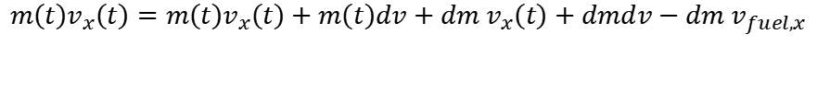
Rocket propulsion
We consider a rocket propagating in outer space (no gravity considered)
$$x$$
Conservation of momentum of the system (rocket+fuel), because there is no external forces exerted on it:
$$m\left(t\right)v_{x}\left(t\right)=\left(m\left(t\right)+dm\right)\left(v_{x}\left(t\right)+dv\right)−dm v_{fuel,x}$$
$$m\left(t\right)v_{x}\left(t\right)=m\left(t\right)v_{x}\left(t\right)+m\left(t\right)dv+dm v_{x}\left(t\right)+dmdv−dm v_{fuel,x}$$
Notes:
PARLER LENTEMENT: You can see that the product of the mass of the rocket multiplied by its x-velocity can be eliminated at both sizes of the equation

Slide 17

Rocket propulsion
We consider a rocket propagating in outer space (no gravity considered)
$$x$$
Conservation of momentum of the system (rocket+fuel), because there is no external forces exerted on it:
$$m\left(t\right)v_{x}\left(t\right)=\left(m\left(t\right)+dm\right)\left(v_{x}\left(t\right)+dv\right)−dm v_{fuel,x}$$
$$m\left(t\right)v_{x}\left(t\right)=m\left(t\right)v_{x}\left(t\right)+m\left(t\right)dv+dm v_{x}\left(t\right)+dmdv−dm v_{fuel,x}$$
$$0=m(t)dv+dm v_{x}\left(t\right)+dm dv−dm\left(v_{x}\left(t\right)−v_{ex}\right)$$
Notes:
PARLER LENTEMENT: We obtain this expression. I replace also the x-velocity of the burned fuel by its expression.

Slide 18

Rocket propulsion
We consider a rocket propagating in outer space (no gravity considered)
$$x$$
$$0=mdv+dm v_{x}\left(t\right)+dm dv−dm\left(v_{x}\left(t\right)−v_{ex}\right)$$
$dm$ $dv$ can be neglected in respect to the other quantities (because it’s a product between two infinitesimal quantities).
Notes:
PARLER LENTEMENT: We can simplify again this expression. The product between the infinitesimal change of mass and the infinitesimal change of velocity can be neglected because much more smaller than the other terms, so we consider it as equals 0.

Slide 19

Rocket propulsion
We consider a rocket propagating in outer space (no gravity considered)
$$x$$
$$0=mdv+dm v_{x}\left(t\right)+dm dv−dm\left(v_{x}\left(t\right)−v_{ex}\right)$$
$dm$ $dv$ can be neglected in respect to the other quantities (because it’s a product between two infinitesimal quantities).
We obtain:
$$dv=\frac{−v_{ex}dm }{m}$$
Notes:
PARLER LENTEMENT: Finally, we obtain an expression of the change of velocity of the rocket.

Slide 20
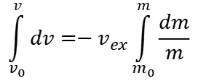
Rocket propulsion
We consider a rocket propagating in outer space (no gravity considered)
$$x$$
$$0=mdv+dm v_{x}\left(t\right)+dm dv−dm\left(v_{x}\left(t\right)−v_{ex}\right)$$
$dm$ $dv$ can be neglected in respect to the other quantities (because it’s a product between two infinitesimal quantities).
We obtain:
$$dv=\frac{−v_{ex}dm }{m}$$
$$\int_{v_{0}}^{v}{dv}=−v_{ex}\int_{m_{0}}^{m}{\frac{dm}{m}}$$
Notes:
PARLER LENTEMENT: We can integrate both sides of the equations, for the velocity of the rocket, it is from the velocity at initial time t zero to the velocity at time t. For the mass, it is from the initial mass m zero to the mass of the rocket at time t. This kind of integral is easy to calculate.

Slide 21

Rocket propulsion
We consider a rocket propagating in outer space (no gravity considered)
$$x$$
$$0=mdv+dm v_{x}\left(t\right)+dm dv−dm\left(v_{x}\left(t\right)−v_{ex}\right)$$
$dm$ $dv$ can be neglected in respect to the other quantities (because it’s a product between two infinitesimal quantities).
We obtain:
$$dv=\frac{−v_{ex}dm }{m}$$
$$\int_{v_{0}}^{v}{dv}=−v_{ex}\int_{m_{0}}^{m}{\frac{dm}{m}}$$
You don’t need to remember this expression (but you must be able to apply the principle of conservation of momentum …)
$$v\left(t\right)−v_{0}=−v_{ex}\ln{\frac{m\left(t\right)}{m_{0}}}=v_{ex}\ln{\frac{m_{0}}{m(t)}}$$
Notes:
PARLER LENTEMENT: We obtain the following expression for the change of the velocity v minus v0, You don’t have to remember this expression, but you should remember the principle of conservation of the momentum and apply it. That’s all about the momentum. Let’s see the next lesson.

Slide 22

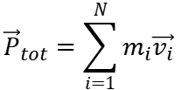

Summary of lesson 6
$$\vec{p}=m\vec{v}$$
The expression of the momentum of a particle:
momentum
Velocity vector
mass
$${\vec{P}}_{tot}=\sum_{i=1}^{N}{m_{i}\vec{v_{i}}}$$
momentum of a system of N particles:
momentum of a body of mass $M=\int{dm}$:
$$\vec{P}=M{\vec{v}}_{cm}=M\frac{d{\vec{r}}_{cm}}{dt}$$
Notes:
PARLER LENTEMENT: Here is a summary of the important content of the lesson. First is the expression of the momentum of a particle. It is the mass multiplied by the velocity vector. For a body of mass M which is not a particle, it is the mass of the body multiplied by the velocity vector of its center of mass. For a system of particles, it the sum of the momentum of the particles in the system.

Slide 23
Summary of lesson 6
$$\vec{p}=m\vec{v}$$
The expression of the momentum of a particle:
momentum
Velocity vector
mass
The Newton’s second law for the momentum:
$$\frac{d\vec{p}}{dt}=\vec{F}$$
Net force exerted
Change rate of momentum
Notes:
PARLER LENTEMENT: And we have described the change rate of the momentum, which corresponds to the net force exerted on the particle. For a system of particles the net force exerted on the particles is the sum of the external forces because the internal forces between particles in the system cancel to each other,

Slide 24
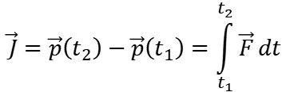
Summary of lesson 6
The Newton’s second law for the momentum:
$$\frac{d\vec{p}}{dt}=\vec{F}$$
Net force exerted
Change rate of momentum
The impulse-momentum theorem:
$$\vec{J}=\vec{p}\left(t_{2}\right)−\vec{p}\left(t_{1}\right)=\int_{t_{1}}^{t_{2}}{\vec{F}}dt$$
Notes:
PARLER LENTEMENT; Also, we have described the impulse momentum theorem. The change of momentum correspond to the impulse done by the net force exerted. The impulse is described by the vector J here.

Slide 25
Summary of lesson 6
The Newton’s second law for the momentum:
$$\frac{d\vec{p}}{dt}=\vec{F}$$
Net force exerted
Change rate of momentum
The impulse-momentum theorem:
$$\vec{J}=\vec{p}\left(t_{2}\right)−\vec{p}\left(t_{1}\right)=\int_{t_{1}}^{t_{2}}{\vec{F}}dt$$
Principle of conservation of the momentum: if no net force are exerted on a system (or if the sum of external forces exerted is zero), the momentum of the system don’t change.
Notes:
PARLER LENTEMENT: We have seen the principle of conservation of the momentum: if no net force are exerted on a system, its momentum don’t change. This principle is useful to describe collisions between bodies.

Slide 26
Summary of lesson 6
The Newton’s second law for the momentum:
$$\frac{d\vec{p}}{dt}=\vec{F}$$
Net force exerted
Change rate of momentum
The impulse-momentum theorem:
$$\vec{J}=\vec{p}\left(t_{2}\right)−\vec{p}\left(t_{1}\right)=\int_{t_{1}}^{t_{2}}{\vec{F}}dt$$
Principle of conservation of the momentum: if no net force are exerted on a system (or if the sum of external forces exerted is zero), the momentum of the system don’t change.
And also the different kinds of collisions: elastic, inelastic, completely inelastic.

Slide 27
University physics, classical mechanics. Lesson 7:Rotation of rigid bodies
Teacher: Dr. Paul Briard
Wechat: Paulbg123
Notes:
PARLER LENTEMENT: Let’s begin the seven-th lesson which is about the rotational motion. I said you before that the motion of a body is translational and rotational. With the Newton second law, we describe its translational motion. Now, let’s see how to describe the rotational motion of a body. Here it said rigid bodies, which means we consider bodies which the shape don’t change during the motion.

Slide 28
Contents
Rotational kinematics
The moment of inertia
Notes:
PARLER LENTEMENT: First I will describe you rotational kinematics. Then, I will describe you the moment of inertia of a body, As the translational motion of a body depends on its mass, the rotational motion of a body depends on his moment of inertia.

Slide 29
Contents
Rotational kinematics
The moment of inertia
The rotational kinetic energy
Notes:
PARLER LENTEMENT: And as a body as translational kinetic energy, it has also a rotational kinetic energy. We will see during this lesson that there are lot of analogies between the translational motion and the rotational motion.

Slide 30
Contents
Rotational kinematics
The moment of inertia
The rotational kinetic energy
Torque applied to a body
Notes:
PARLER LENTEMENT: As a force push a body to move it force instance, a torque could permit to rotate a body. A torque is related to the force which rotates the body.

Slide 31
Contents
Rotational kinematics
The moment of inertia
The rotational kinetic energy
Torque applied to a body
Rotational dynamics law (similar with Newton’s 2nd law)
Notes:
PARLER LENTEMENT: Then we will see the rotational analogy of the Newton second law.

Slide 32
Contents
Rotational kinematics
The moment of inertia
The rotational kinetic energy
Torque applied to a body
Rotational dynamics law (similar with Newton’s 2nd law)
The work done by an applied torque
The angular momentum
Notes:
PARLER LENTEMENT: To finish, I will describe you the work done by a torque and the angular momentum of a body. As you can see, this lesson has many contents and we will need more than one lecture to see all of them.

Slide 33
1. Rotational kinematics
Notes:
PARLER LENTEMENT: So first, let’s describe the Rotational kinematics.

Slide 34
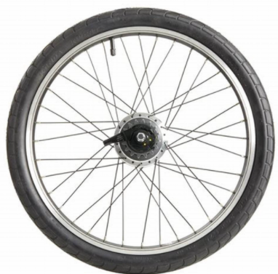

The angular velocity: introduction
$$r$$
$$s=rθ$$
$$θ$$
$$\vec{v}$$
$$\vec{v}$$
We consider the circular motion (for instance of a point of a wheel in rotation), along a circle of radius $r.$ The magnitude of the velocity vector is:
Notes:
PARLER LENTEMENT: First, we consider a circular motion, for instance the motion of a point of the wheel at the right which is rotating. This point as a velocity vector v. The circular motion is along a circle of radius r as you see on the figure at the left. The path s travelled between two times correspond to the angle theta, and is what I have described you by the curvilinear coordinate s. s equals the radius of the circle multiplied by the angle theta.

Slide 35
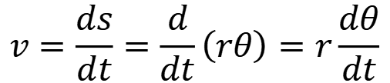
The angular velocity: introduction
$$r$$
$$s=rθ$$
$$θ$$
$$\vec{v}$$
$$\vec{v}$$
We consider the circular motion (for instance of a point of a wheel in rotation), along a circle of radius $r.$ The magnitude of the velocity vector is:
$$v=\frac{ds}{dt}=\frac{d}{dt}\left(rθ\right)=r\frac{dθ}{dt}$$
Notes:
PARLER LENTEMENT: We can describe the velocity v as ds divided by dt. We can describe it also by the radius of the circle multiplied by the change rate of angle theta, which is d_theta divided by dt.

Slide 36
The angular velocity: introduction
$$r$$
$$s=rθ$$
$$θ$$
$$\vec{v}$$
$$\vec{v}$$
We consider the circular motion (for instance of a point of a wheel in rotation), along a circle of radius $r.$ The magnitude of the velocity vector is:
$$v=\frac{ds}{dt}=\frac{d}{dt}\left(rθ\right)=r\frac{dθ}{dt}$$
${dθ}/{dt}$describes the angular velocity
Notes:
PARLER LENTEMENT: The change rate of the angle theta is also the angular velocity. You can see how it is related with the velocity vector v.

Slide 37




The angular velocity
$$y$$
$$\vec{v}$$
at time ${t=t}_{2}$
at time ${t=t}_{1}$
$$r$$
$$∆θ$$
$$θ(t_{2})$$
$$z$$
$$x$$
Notes:
PARLER LENTEMENT: Now let’s give more details about the angular velocity, We consider a particle moving from an angular position at time t_1 to an angular position at time t2. We say that theta is the angular position of the particle, in respect with the x-axis. A change of angular position is described by the angle delta theta.

Slide 38
The angular velocity
$$y$$
$$\vec{v}$$
at time ${t=t}_{2}$
at time ${t=t}_{1}$
$$r$$
$$∆θ$$
$$θ$$
$$z$$
$$x$$
We choose the z-axis as the axis of the rotational motion.
Notes:
PARLER LENTEMENT: And which choose that the z-axis is the axis of the rotational motion., which means the particle turns around the z-axis.

Slide 39

The angular velocity
$$y$$
$$\vec{v}$$
at time ${t=t}_{2}$
at time ${t=t}_{1}$
$$r$$
$$∆θ$$
$$θ$$
$$z$$
$$x$$
We choose the z-axis as the axis of the rotational motion.
The average angular velocity during a time interval $∆t=t_{2}−t_{1}$ is:
$$ω_{z,av}=\frac{∆θ}{∆t}=\frac{θ_{2}−θ_{1}}{t_{2}−t_{1}}$$
Notes:
PARLER LENTEMENT The average angular velocity of the particle between times t_1 and t_2 is described as follows, it is the change of angular position delta theta divided by the time interval delta t.

Slide 40
The angular velocity
$$y$$
$$\vec{v}$$
at time ${t=t}_{2}$
at time ${t=t}_{1}$
$$r$$
$$∆θ$$
$$θ$$
$$z$$
$$x$$
We choose the z-axis as the axis of the rotational motion.
The average angular velocity during a time interval $∆t=t_{2}−t_{1}$ is:
$$ω_{z,av}=\frac{∆θ}{∆t}=\frac{θ_{2}−θ_{1}}{t_{2}−t_{1}}$$
where $∆θ$ is the angular displacement, from $θ_{1}=θ({t=t}_{1})$ to $θ_{2}=θ(t=t_{2})$
Notes:
PARLER LENTEMENT: Where delta theta is the change of angular position. Here the particle could have any rotational motion, what does matter is what are its initial and final angular position theta one and theta two.

Slide 41
The angular velocity
$$y$$
$$\vec{v}$$
at time ${t=t}_{2}$
at time ${t=t}_{1}$
$$r$$
$$∆θ$$
$$θ$$
$$z$$
$$x$$
We choose the z-axis as the axis of the rotational motion.
The average angular velocity during a time interval $∆t=t_{2}−t_{1}$ is:
$$ω_{z,av}=\frac{∆θ}{∆t}=\frac{θ_{2}−θ_{1}}{t_{2}−t_{1}}$$
where $∆θ$ is the angular displacement, from $θ_{1}=θ({t=t}_{1})$ to $θ_{2}=θ(t=t_{2})$
If $∆t→0$, we obtain the instantaneous angular velocity:
Notes:
PARLER LENTEMENT: Now let’s consider the time interval become infinitely small, in that case, we describe the instantenous angular velocity of the particle.

Slide 42

The angular velocity
$$y$$
$$\vec{v}$$
at time ${t=t}_{2}$
at time ${t=t}_{1}$
$$r$$
$$∆θ$$
$$θ$$
$$z$$
$$x$$
We choose the z-axis as the axis of the rotational motion.
The average angular velocity during a time interval $∆t=t_{2}−t_{1}$ is:
$$ω_{z,av}=\frac{∆θ}{∆t}=\frac{θ_{2}−θ_{1}}{t_{2}−t_{1}}$$
where $∆θ$ is the angular displacement, from $θ_{1}=θ({t=t}_{1})$ to $θ_{2}=θ(t=t_{2})$
If $∆t→0$, we obtain the instantaneous angular velocity:
$$ω_{z}=\lim_{∆t→0}{\frac{∆θ}{∆t}}=\frac{dθ}{dt}$$
$dθ$ is an infinitesimal angular displacement
Notes:
PARLER LENTEMENT: This instantaneous angular velocity is the infinitesimal change of angular position divided by the infinitesimal time dt. I write omega with a subscript z because the particle turn around the z-axis. Also, the expression you see here describe the z-component of the angular velocity vector.

Slide 43

The angular velocity
$$y$$
$$\vec{v}$$
$$r$$
$$θ$$
$$+$$
$$z$$
$$x$$
The motion could be clockwise or anti-clockwise. As we choose positive directions for the linear coordinate x,y,z, it is convenient to choose a positive sign corresponding to anti-clockwise motion.
Notes:
PARLER LENTEMENT: I will describe more details about the angular velocity vector later. First, let’s see about the sign of omega_z. The rotational motion could be be clockwise or anti-clockwise. As we choose positive directions for the linear coordinate x,y,z, it is convenient to choose a positive sign corresponding to anti-clockwise motion.

Slide 44




The angular velocity
$$y$$
$$\vec{v}$$
$$r$$
$$θ$$
$$+$$
$$z$$
$$x$$
The motion could be clockwise or anti-clockwise. As we choose positive directions for the linear coordinate x,y,z, it is convenient to choose a positive sign corresponding to anti-clockwise motion.
If the motion is anti-clockwise
$$dθ>0$$
$$ω_{z}>0$$
If the motion is clockwise
$$dθ<0$$
$$ω_{z}<0$$
Notes:
PARLER LENTEMENT: The sign of omega_z depends to if the motion is clockwise or anticlockwise. If the motion is anticlockwise, the infinitesimal change of theta is positive with the convention we have chosen, which means omega_z is position. If the rotational motion is clockwise, omega_z is negative.

Slide 45
Rest time (5 minutes)

Slide 46



The angular velocity vector
$$y$$
$$\vec{v}$$
Direction of $\vec{ω}$
Anti-clockwise motion
$$r$$
$$θ$$
$$z$$
$$x$$
Clockwise motion
Magnitude of $\vec{ω}$
$$ω=\left|\vec{ω}\right|=\left|r\frac{dθ}{dt}\right|=\left|ω_{z}\right|$$
Notes:
PARLER LENTEMENT: So, let’s speak about the angular velocity vector omega. It has two possible directions. If the motion is anticlock-wise, the direction of the angular velocity vector is the +z-direction. If the motion is clockwise, the direction of angular velocity vector is the –z-direction. About the magnitude of the velocity vector, you can that it is the absolute value of omega_z, its z-component.

Slide 47
The angular velocity vector
$$y$$
$$\vec{v}$$
Direction of $\vec{ω}$
Anti-clockwise motion
$$r$$
$$θ$$
$$z$$
$$x$$
Clockwise motion
Magnitude of $\vec{ω}$
$$ω=\left|\vec{ω}\right|=\left|r\frac{dθ}{dt}\right|=\left|ω_{z}\right|$$
Why it is more interesting to study $ω_{z}$ rather than $ω=\left|ω_{z}\right|$ , if both represent an angular velocity associated with the motion ?
Notes:
PARLER LENTEMENT: So, we could study the magnitude of the velocity vector instead of omega_z. because both of them describe an angular velocity associated with a circular motion. In that case, why it is interesting to study omega_z rather than the magnitude of the velocity vector ?

Slide 48
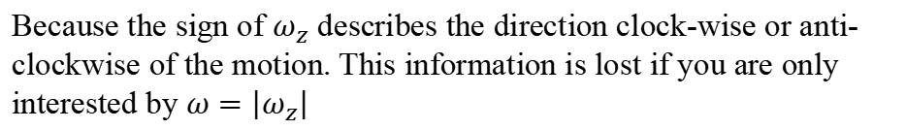
The angular velocity vector
$$y$$
$$\vec{v}$$
Direction of $\vec{ω}$
Anti-clockwise motion
$$r$$
$$θ$$
$$z$$
$$x$$
Clockwise motion
Why it is more interesting to study $ω_{z}$ rather than $ω=\left|ω_{z}\right|$ , if both represent an angular velocity associated with the motion ?
Because the sign of $ω_{z}$ describes the direction clock-wise or anti-clockwise of the motion. This information is lost if you are only interested by $ω=\left|ω_{z}\right|$
Notes:
PARLER LENTEMENT: this is because the magnitude of a vector is always positive. And the direction of the angular velocity vector says if the motion is clockwise or anticlockwise. So, usually, it is more interesting to study the z-component of an angular velocity vector rather than its magnitude. omega_z is not the magnitude of the angular velocity vector, but it will be more convenient for me to call it the “angular velocity” of the particle rather that say every time “the z-component of the angular velocity vector”.

Slide 49



The angular velocity vector
Take care also that $ω_{z}$ depends to the time (and its sign depends to the time), we could write the angular velocity $ω_{z}(t)$
Example of a rotational motion:
$$ω_{z}(t)$$
$$ω_{z}=0$$
$t$ (time)
Notes:
PARLER LENTEMENT: Take care that the angular velocity depends on the time, even we omit the time after the symbol of the angular velocity. This graph show a possible rotational motion, where omega_z change with the time.

Slide 50

The angular velocity vector
Take care also that $ω_{z}$ depends to the time (and its sign depends to the time), we could write the angular velocity $ω_{z}(t)$
Example of a rotational motion:
$$ω_{z}(t)$$
$$ω_{z}=0$$
$$\frac{dθ}{dt}=0$$
$$ω_{z}=0$$
$t$ (time)
Notes:
PARLER LENTEMENT: In this example, you can that there could be time where the angular velocity is zero.

Slide 51
The angular velocity vector
Take care also that $ω_{z}$ depends to the time (and its sign depends to the time), we could write the angular velocity $ω_{z}(t)$
Example of a rotational motion:
$$ω_{z}(t)$$
$$ω_{z}=0$$
$$\frac{dθ}{dt}=0$$
$$ω_{z}=0$$
$t$ (time)
Motion anti-clockwise
Motion clockwise
Notes:
PARLER LENTEMENT: Also, the sign of omega_z says if the motion is anti-clockwise or clock-wize.

Slide 52
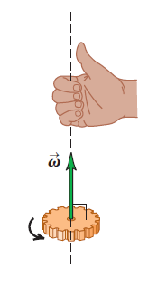
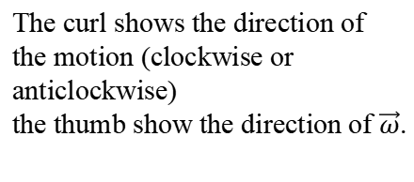
The angular velocity vector
$$y$$
$$\vec{v}$$
Direction of $\vec{ω}$
Anti-clockwise motion
$$r$$
$$θ$$
$$z$$
$$x$$
Clockwise motion
To remember easily the direction of angular velocity vector $\vec{ω}$, use a right-hand rule:
The curl shows the direction of the motion (clockwise or anticlockwise)
the thumb show the direction of $\vec{ω}$.
Notes:
PARLER LENTEMENT: To remember the direction of angular velocity vector, we can use a right-hand rule. With your right hand, as in the figure, your thumb show the direction of the z-axis. The direction of the thumb is the direction of the angular velocity vector. The curl of the other figure show if the motion is clockwise or anticlockwise. For this example, the angular velocity vector is upward and the motion is anti-clockwise.

Slide 53

The angular acceleration
$$y$$
$$\vec{v}$$
Direction of $\vec{ω}$
Anti-clockwise motion
$$\vec{r}$$
$$θ$$
$$z$$
$$x$$
Clockwise motion
As there is a linear acceleration which describe the change rate of the velocity, there is an angular acceleration which describe the change rate of the angular velocity.
$$ω_{z}=\frac{dθ}{dt}$$
Notes:
PARLER LENTEMENT:As there is a linear acceleration which describe the change rate of the velocity, there is an angular acceleration which describe the change rate of the angular velocity. We know that omega_z is the change rate of the angular position.

Slide 54
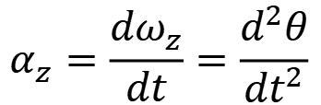
The angular acceleration
$$y$$
$$\vec{v}$$
Direction of $\vec{ω}$
Anti-clockwise motion
$$\vec{r}$$
$$θ$$
$$z$$
$$x$$
Clockwise motion
As there is a linear acceleration which describe the change rate of the velocity, there is an angular acceleration which describe the change rate of the angular velocity.
$$α_{z}=\frac{dω_{z}}{dt}=\frac{d^{2}θ}{{dt}^{2}}$$
$$ω_{z}=\frac{dθ}{dt}$$
angular acceleration
(more accurately, “the z-component of the angular acceleration vector”)
Notes:
PARLER LENTEMENT: We obtain the description of the z-component of the angular acceleration named alpha z. In book you can say its describe the angular acceleration, but is more accurate to say its describes the z-component of the angular acceleration vector. The angular acceleration vector describes the change rate of the velocity vector so it is also directed toward the +z-direction or the –z-direction depending to how change the angular velocity. To simplify, I will say “angular acceleration”, but take care that it can be positive or negative, so it don’t describe the magnitude of the angular acceleration vector.

Slide 55
The angular acceleration
$$y$$
$$\vec{v}$$
Direction of $\vec{ω}$
Anti-clockwise motion
$$\vec{r}$$
$$θ$$
$$z$$
$$x$$
Clockwise motion
Between two times $t_{1}$ and $t_{2}$, the average angular acceleration $α_{av,z}$ is:
Notes:
PARLER LENTEMENT: As we can describe an average angular velocity between two times, we can describe an average angular acceleration between two times.

Slide 56
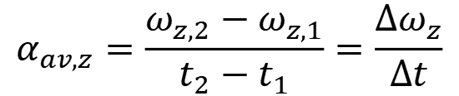

The angular acceleration
$$y$$
$$\vec{v}$$
Direction of $\vec{ω}$
Anti-clockwise motion
$$\vec{r}$$
$$θ$$
$$z$$
$$x$$
Clockwise motion
Between two times $t_{1}$ and $t_{2}$, the average angular acceleration $α_{av,z}$ is:
$$α_{av,z}=\frac{ω_{z,2}−ω_{z,1}}{t_{2}−t_{1}}=\frac{∆ω_{z}}{∆t}$$
where $ω_{z,1}=ω_{z}(t=t_{1})$ and $ω_{z,2}=ω_{z}(t=t_{2})$
Notes:
PARLER LENTEMENT: The average angular acceleration is the ratio between the change of angular velocity between two times and the time interval.

Slide 57
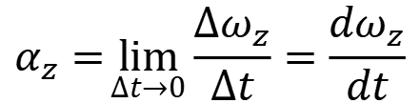
The angular acceleration
$$y$$
$$\vec{v}$$
Direction of $\vec{ω}$
Anti-clockwise motion
$$\vec{r}$$
$$θ$$
$$z$$
$$x$$
Clockwise motion
Between two times $t_{1}$ and $t_{2}$, the average angular acceleration $α_{av,z}$ is:
$$α_{av,z}=\frac{ω_{z,2}−ω_{z,1}}{t_{2}−t_{1}}=\frac{∆ω_{z}}{∆t}$$
where $ω_{z,1}=ω_{z}(t=t_{1})$ and $ω_{z,2}=ω_{z}(t=t_{2})$
If $∆t→0$, we obtain the instantaneous angular acceleration:
$$α_{z}=\lim_{∆t→0}{\frac{∆ω_{z}}{∆t}}=\frac{dω_{z}}{dt}$$
Notes:
PARLER LENTEMENT: If this time interval become infinitely small, then we obtain the expression of the angular acceleration,

Slide 58

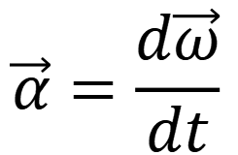
The angular acceleration
$$y$$
$$\vec{v}$$
Direction of $\vec{ω}$
Anti-clockwise motion
$$\vec{r}$$
$$θ$$
$$z$$
$$x$$
Clockwise motion
$$\vec{α}=\frac{d\vec{ω}}{dt}$$
Angular acceleration vector $\vec{α}$:
Notes:
PARLER LENTEMENT: We can also express the angular acceleration vector as the change rate of the angular velocity vector.

Slide 59
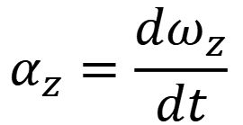
The angular acceleration
$$y$$
$$\vec{v}$$
Direction of $\vec{ω}$
Anti-clockwise motion
$$\vec{r}$$
$$θ$$
$$z$$
$$x$$
Clockwise motion
$$\vec{α}=\frac{d\vec{ω}}{dt}$$
Angular acceleration vector $\vec{α}$:
$$α_{z}=\frac{dω_{z}}{dt}$$
The angular acceleration $α_{z}$ is the z-component of the angular acceleration vector $\vec{α}$and can be positive or negative.
Notes:
PARLER LENTEMENT: We obtain that the z-component of the angular acceleration vector is the change rate of z-component of the angular velocity vector. Take care here also that the magnitude of a vector is always positive but alpha_z can be positive or negative depending to how change the angular velocity,

Slide 60
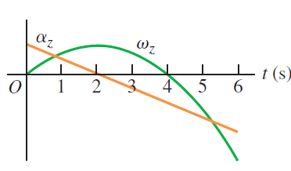
The angular acceleration
$$α_{z}=\frac{dω_{z}}{dt}$$
$\vec{α}$ and $\vec{ω}$ are along the same axis but could have the same direction or opposite direction (depending if the rotational motion speeding or speeding down).
Example:
Notes:
PARLER LENTEMENT: Here you can see an example of rotational motion, alpha z and omega z can have positive or negative sign, they can have same sign or opposite sign.

Slide 61
The angular acceleration
$$α_{z}=\frac{dω_{z}}{dt}$$
$\vec{α}$ and $\vec{ω}$ are along the same axis but could have the same direction or opposite direction (depending if the rotational motion speeding or speeding down).
Example:
Same sign, the rotation speeding up
Notes:
PARLER LENTEMENT: From the time zero second to the time 2 seconds, they have the same sign which means the rotation is speeding up.

Slide 62
The angular acceleration
$$α_{z}=\frac{dω_{z}}{dt}$$
$\vec{α}$ and $\vec{ω}$ are along the same axis but could have the same direction or opposite direction (depending if the rotational motion speeding or speeding down).
Example:
Same sign, the rotation speeding up
Opposite sign, the rotation speeding down.
Notes:
PARLER LENTEMENT: From two seconds to four seconds they have opposite signs, which means the rotation is speeding down,

Slide 63
The angular acceleration
$$α_{z}=\frac{dω_{z}}{dt}$$
$\vec{α}$ and $\vec{ω}$ are along the same axis but could have the same direction or opposite direction (depending if the rotational motion speeding or speeding down).
Example:
Same sign, the rotation speeding up.
Same sign, the rotation speeding up
Opposite sign, the rotation speeding down.
Notes:
PARLER LENTEMENT: And after 4 seconds, they have same sign again, which means the rotation is speeding up. The sign of omega z says you if the motion is clockwise or anticlockwise.

Slide 64
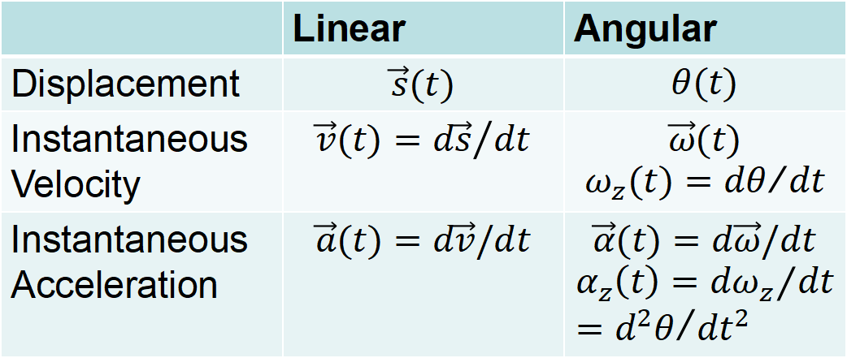
Summary
 | Linear | Angular
Displacement | $$\vec{s}(t)$$ | $$θ(t)$$
Instantaneous Velocity | $${\vec{v}(t)=d\vec{s}}/{dt}$$ | $$\vec{ω}(t)$$ $$ω_{z}(t)={dθ}/{dt}$$
Instantaneous Acceleration | $$\vec{a}(t)=d\vec{v}/dt$$ | $$\vec{α}(t)=d\vec{ω}/dt$$ $$α_{z}\left(t\right)={dω_{z}}/{dt}={d^{2}θ}/{dt^{2}}$$
Notes:
PARLER LENTEMENT: Here is a summary of what we have seen, as you see there is analogies between the linear motion and the translation motion. As there is a linear displacement, there is an angular displacement, As there is a linear velocity vector, there is an angular velocity vector. We describe also the angular velocity as the change rate of the angular displacement. As there is a linear acceleration vector, there is an angular acceleration vector. We describe also the angular acceleration as the change rate of the angular velocity.

Slide 65
Particular case: the uniform circular motion
In uniform circular motion, the magnitude of the velocity vector is constant.
$$\vec{v}$$
$$\vec{v}$$
$$\vec{r}$$
$$θ$$
$$z$$
$$x$$
Notes:
PARLER LENTEMENT: Now let’s see the particular case of the uniform circular motion. In this case, the magnitude of the velocity vector stay constant. And if the motion is anticlockwise as in the figure, its says anticlockwise,

Slide 66
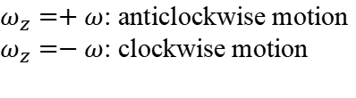


Particular case: the uniform circular motion
In uniform circular motion, the magnitude of the velocity vector is constant.
$$\vec{v}$$
$$\vec{v}$$
$$\vec{r}$$
$$θ$$
$$z$$
$$x$$
$$v=rω$$
$${ω=v}/{r=constant}$$
$ω_{z}=+ω$: anticlockwise motion
$ω_{z}=−ω$: clockwise motion
Notes:
PARLER LENTEMENT: We obtain that the angular velocity stay constant. About omega_z it is equal to + or minus the magnitude of the angular velocity vector depends to of the motion is anticlockwise or clockwise. In that situation we could study omega rather than omega_z.

Slide 67

Particular case: the uniform circular motion
In uniform circular motion, the magnitude of the velocity vector is constant.
$$\vec{v}$$
$$\vec{v}$$
$$\vec{r}$$
$$θ$$
$$z$$
$$x$$
$$v=rω$$
$${ω=v}/{r=constant}$$
$ω_{z}=+ω$: anticlockwise motion
$ω_{z}=−ω$: clockwise motion
$$α_{z}=\frac{dω_{z}}{dt}=0$$
The angular acceleration equals zero.
Notes:
PARLER LENTEMENT: And about the angular acceleration, the angular acceleration is zero.

Slide 68

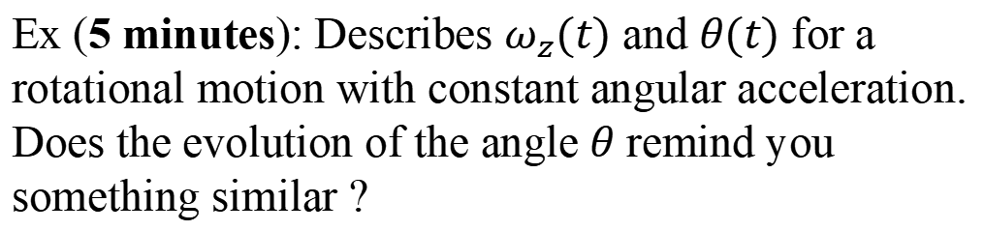

Particular case: Rotation uniformly accelerated
Constant angular acceleration
$$α_{z}=constant$$
At the time ${t=t}_{0}=0$, the angular velocity is $ω_{z}\left(t_{0}\right)=ω_{0,z}$
At the time ${t=t}_{0}=0$, the angular position is $θ\left(t_{0}\right)=θ_{0}$
Ex (5 minutes): Describes $ω_{z}(t)$ and $θ(t)$ for a rotational motion with constant angular acceleration. Does the evolution of the angle $θ$ remind you something similar ?
$$ω_{z}(t)$$
$$θ(t)$$
$$t$$
$$t$$
Notes:
PARLER LENTEMENT: So here, is a little exercise. Please to describe by equations the angular velocity and the angular displacement corresponding to a constant angular acceleration. Maybe this exercise will reminds you something. Take care that here the motion is not a uniform circular motion. The angular acceleration is constant.

Slide 69
Particular case: Rotation uniformly accelerated
Constant angular acceleration
$$α_{z}=constant$$
At the time ${t=t}_{0}=0$, the angular velocity is $ω_{z}\left(t_{0}\right)=ω_{0,z}$
Notes:
PARLER LENTEMENT: Let’s see how to describe a motion uniformly accelerated. Here the motion is not a uniform circular motion, The angular acceleration is constant. At the initial time t equals zero, the angular velocity omega_z is omega_zero_z.

Slide 70


Particular case: Rotation uniformly accelerated
Constant angular acceleration
$$α_{z}=constant$$
At the time ${t=t}_{0}=0$, the angular velocity is $ω_{z}\left(t_{0}\right)=ω_{0,z}$
$$α_{z}=\frac{dω_{z}}{dt}$$
$$dω_{z}=α_{z}dt$$
Notes:
PARLER LENTEMENT: A change of this angular velocity is the production between the angular acceleration alpha z multiplied by the infinitesimal time dt.

Slide 71
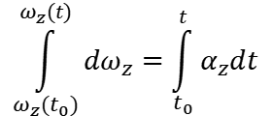
Particular case: Rotation uniformly accelerated
Constant angular acceleration
$$α_{z}=constant$$
At the time ${t=t}_{0}=0$, the angular velocity is $ω_{z}\left(t_{0}\right)=ω_{0,z}$
$$\int_{ω_{z}(t_{0})}^{ω_{z}(t)}{dω_{z}}=\int_{t_{0}}^{t}{α_{z}dt}$$
$$α_{z}=\frac{dω_{z}}{dt}$$
$$dω_{z}=α_{z}dt$$
Notes:
PARLER LENTEMENT: We can do the integral of both sides of the equation from the initial time to the time t at the right of the equation and from the initial angular velocity to the angular velocity at time t at the left of the equation.

Slide 72
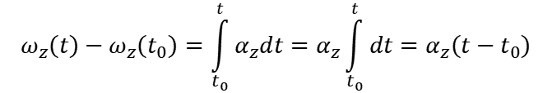
Particular case: Rotation uniformly accelerated
Constant angular acceleration
$$α_{z}=constant$$
At the time ${t=t}_{0}=0$, the angular velocity is $ω_{z}\left(t_{0}\right)=ω_{0,z}$
$$\int_{ω_{z}(t_{0})}^{ω_{z}(t)}{dω_{z}}=\int_{t_{0}}^{t}{α_{z}dt}$$
$$α_{z}=\frac{dω_{z}}{dt}$$
$$dω_{z}=α_{z}dt$$
$$ω_{z}\left(t\right)−ω_{z}\left(t_{0}\right)=\int_{t_{0}}^{t}{α_{z}dt}=α_{z}\int_{t_{0}}^{t}{dt}=α_{z}\left(t−t_{0}\right)$$
Notes:
PARLER LENTEMENT: And the angular acceleration alpha_z is constant, we can put it outside the integral, which permit to describe the change of angular velocity as follows.

Slide 73
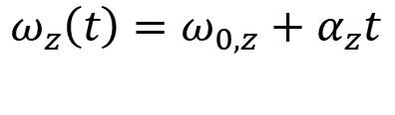
Particular case: Rotation uniformly accelerated
Constant angular acceleration
$$α_{z}=constant$$
At the time ${t=t}_{0}=0$, the angular velocity is $ω_{z}\left(t_{0}\right)=ω_{0,z}$
$$\int_{ω_{z}(t_{0})}^{ω_{z}(t)}{dω_{z}}=\int_{t_{0}}^{t}{α_{z}dt}$$
$$α_{z}=\frac{dω_{z}}{dt}$$
$$dω_{z}=α_{z}dt$$
$$ω_{z}\left(t\right)−ω_{z}\left(t_{0}\right)=\int_{t_{0}}^{t}{α_{z}dt}=α_{z}\int_{t_{0}}^{t}{dt}=α_{z}\left(t−t_{0}\right)$$
$$ω_{z}\left(t\right)=ω_{0,z}+α_{z}t$$
Notes:
PARLER LENTEMENT: The initial time t zero is equal zero, thus the angular velocity omega_z is simply described as follows.

Slide 74

Particular case: Rotation uniformly accelerated
At the time ${t=t}_{0}=0$, the angular velocity is $ω_{z}\left(t_{0}\right)=ω_{0,z}$
$$ω_{z}\left(t\right)=ω_{0,z}+α_{z}t$$
At the time $t=t_{0}=0$, the angular position is $θ\left(t_{0}\right)=θ_{0}$
$$ω_{z}=\frac{dθ}{dt}$$
$$dθ=ω_{z}dt$$
Notes:
PARLER LENTEMENT: Now, let’s describe the angular displacement. An infinitesimal change of angle theta is the angular velocity omega_z multiplied by the infinitesimal time interval dt.

Slide 75
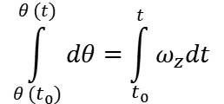
Particular case: Rotation uniformly accelerated
At the time ${t=t}_{0}=0$, the angular velocity is $ω_{z}\left(t_{0}\right)=ω_{0,z}$
$$ω_{z}\left(t\right)=ω_{0,z}+α_{z}t$$
At the time $t=t_{0}=0$, the angular position is $θ\left(t_{0}\right)=θ_{0}$
$$ω_{z}=\frac{dθ}{dt}$$
$$\int_{θ (t_{0})}^{θ (t)}{dθ}=\int_{t_{0}}^{t}{ω_{z}dt}$$
$$dθ=ω_{z}dt$$
Notes:
PARLER LENTEMENT: We can add the integrals at both sides of the equation as previously, but take care that here, the angular velocity is not constant, we cannot put it outside the integral.

Slide 76
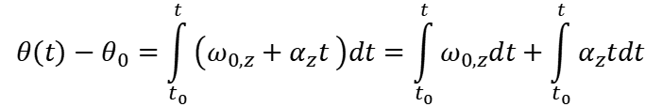
Particular case: Rotation uniformly accelerated
At the time ${t=t}_{0}=0$, the angular velocity is $ω_{z}\left(t_{0}\right)=ω_{0,z}$
$$ω_{z}\left(t\right)=ω_{0,z}+α_{z}t$$
At the time $t=t_{0}=0$, the angular position is $θ\left(t_{0}\right)=θ_{0}$
$$ω_{z}=\frac{dθ}{dt}$$
$$\int_{θ (t_{0})}^{θ (t)}{dθ}=\int_{t_{0}}^{t}{ω_{z}dt}$$
$$dθ=ω_{z}dt$$
$$θ\left(t\right)−θ_{0}=\int_{t_{0}}^{t}{\left(ω_{0,z}+α_{z}t \right)dt}=\int_{t_{0}}^{t}{ω_{0,z}dt}+\int_{t_{0}}^{t}{α_{z}tdt}$$
Notes:
PARLER LENTEMENT: So, the change of angle theta between initial time t zero and time t is a sum of two integrals.

Slide 77

Particular case: Rotation uniformly accelerated
At the time ${t=t}_{0}=0$, the angular velocity is $ω_{z}\left(t_{0}\right)=ω_{0,z}$
$$ω_{z}\left(t\right)=ω_{0,z}+α_{z}t$$
At the time $t=t_{0}=0$, the angular position is $θ\left(t_{0}\right)=θ_{0}$
$$ω_{z}=\frac{dθ}{dt}$$
$$\int_{θ (t_{0})}^{θ (t)}{dθ}=\int_{t_{0}}^{t}{ω_{z}dt}$$
$$dθ=ω_{z}dt$$
$$θ\left(t\right)−θ_{0}=\int_{t_{0}}^{t}{\left(ω_{0,z}+α_{z}t \right)dt}=\int_{t_{0}}^{t}{ω_{0,z}dt}+\int_{t_{0}}^{t}{α_{z}tdt}$$
$$θ\left(t\right)−θ_{0}=ω_{0,z}\left(t−t_{0}\right)+\frac{1}{2}α_{z}t^{2}−\frac{1}{2}α_{z}{t_{0}}^{2}$$
Notes:
PARLER LENTEMENT: We obtain the following result, we can be simplified because the time t_zero equals zero.

Slide 78

Particular case: Rotation uniformly accelerated
At the time ${t=t}_{0}=0$, the angular velocity is $ω_{z}\left(t_{0}\right)=ω_{0,z}$
$$ω_{z}\left(t\right)=ω_{0,z}+α_{z}t$$
At the time $t=t_{0}=0$, the angular position is $θ\left(t_{0}\right)=θ_{0}$
$$ω_{z}=\frac{dθ}{dt}$$
$$\int_{θ (t_{0})}^{θ (t)}{dθ}=\int_{t_{0}}^{t}{ω_{z}dt}$$
$$dθ=ω_{z}dt$$
$$θ\left(t\right)−θ_{0}=\int_{t_{0}}^{t}{\left(ω_{0,z}+α_{z}t \right)dt}=\int_{t_{0}}^{t}{ω_{0,z}dt}+\int_{t_{0}}^{t}{α_{z}tdt}$$
$$θ\left(t\right)−θ_{0}=ω_{0,z}\left(t−t_{0}\right)+\frac{1}{2}α_{z}t^{2}−\frac{1}{2}α_{z}{t_{0}}^{2}$$
$θ\left(t\right)=θ_{0}+ω_{0,z}t+\frac{1}{2}α_{z}t^{2}$
Notes:
PARLER LENTEMENT: And we obtain finally this expression of theta, You can see that it is very similar to the case of when a particle is uniformly accelerated along an axis, as we have seen before.

Slide 79



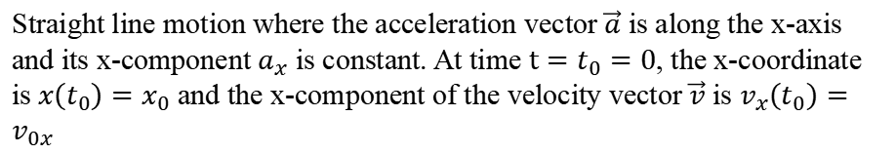
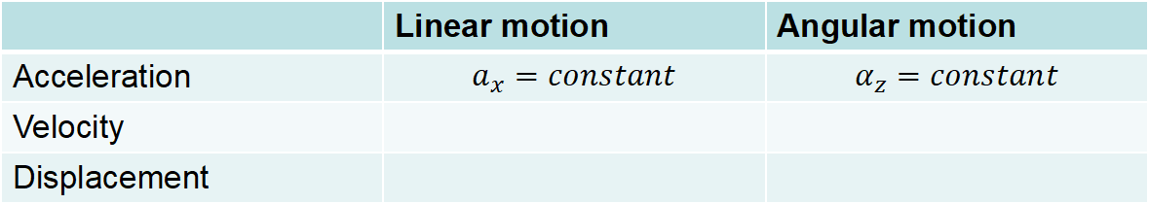
Linear motion and angular motion with constant acceleration
 | Linear motion | Angular motion
Acceleration | $$a_{x}=constant$$ | $$α_{z}=constant$$
Velocity
Displacement
Straight line motion where the acceleration vector $\vec{a}$ is along the x-axis and its x-component $a_{x}$ is constant. At time $t=t_{0}=0$, the x-coordinate is $x\left(t_{0}\right)=x_{0}$ and the x-component of the velocity vector $\vec{v}$ is $v_{x}\left(t_{0}\right)=v_{0x}$
$${\vec{v}}_{0}$$
$$x$$
particle at $t=t_{o}=0$
$$x_{0}$$
Notes:
PARLER LENTEMENT: Let’s to compare both cases, one his the straight line motion with uniform acceleration, the other one is the angular motion with constant angular acceleration,

Slide 80
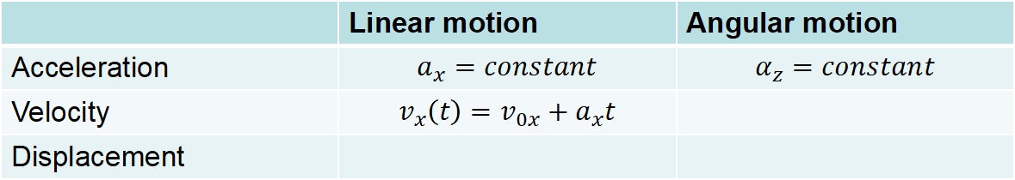
Linear motion and angular motion with constant acceleration
 | Linear motion | Angular motion
Acceleration | $$a_{x}=constant$$ | $$α_{z}=constant$$
Velocity | $$v_{x}\left(t\right)=v_{0x}+a_{x}t$$
Displacement
Straight line motion where the acceleration vector $\vec{a}$ is along the x-axis and its x-component $a_{x}$ is constant. At time $t=t_{0}=0$, the x-coordinate is $x\left(t_{0}\right)=x_{0}$ and the x-component of the velocity vector $\vec{v}$ is $v_{x}\left(t_{0}\right)=v_{0x}$
$${\vec{v}}_{0}$$
$$x$$
particle at $t=t_{o}=0$
$$x_{0}$$
Notes:
PARLER LENTEMENT: The particle move along the x-axis, The x-velocity is described as follows,

Slide 81
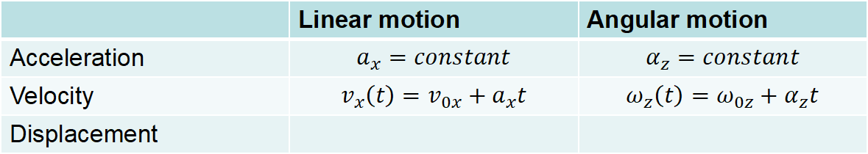
Linear motion and angular motion with constant acceleration
 | Linear motion | Angular motion
Acceleration | $$a_{x}=constant$$ | $$α_{z}=constant$$
Velocity | $$v_{x}\left(t\right)=v_{0x}+a_{x}t$$ | $$ω_{z}\left(t\right)=ω_{0z}+α_{z}t$$
Displacement
Straight line motion where the acceleration vector $\vec{a}$ is along the x-axis and its x-component $a_{x}$ is constant. At time $t=t_{0}=0$, the x-coordinate is $x\left(t_{0}\right)=x_{0}$ and the x-component of the velocity vector $\vec{v}$ is $v_{x}\left(t_{0}\right)=v_{0x}$
$${\vec{v}}_{0}$$
$$x$$
particle at $t=t_{o}=0$
$$x_{0}$$
Notes:
PARLER LENTEMENT: The expression of the angular velocity omega z we have found in the exercise is described as follows.

Slide 82
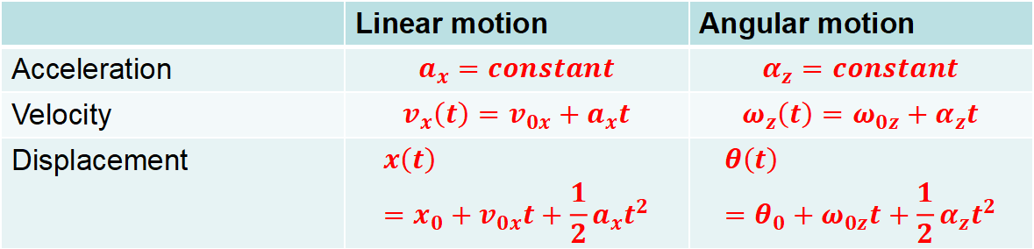
Linear motion and angular motion with constant acceleration
 | Linear motion | Angular motion
Acceleration | $$a_{x}=constant$$ | $$α_{z}=constant$$
Velocity | $$v_{x}\left(t\right)=v_{0x}+a_{x}t$$ | $$ω_{z}\left(t\right)=ω_{0z}+α_{z}t$$
Displacement | $$x\left(t\right)=x_{0}+v_{0x}t+\frac{1}{2}a_{x}t^{2}$$ | $$θ\left(t\right)=θ_{0}+ω_{0z}t+\frac{1}{2}α_{z}t^{2}$$
Straight line motion where the acceleration vector $\vec{a}$ is along the x-axis and its x-component $a_{x}$ is constant. At time $t=t_{0}=0$, the x-coordinate is $x\left(t_{0}\right)=x_{0}$ and the x-component of the velocity vector $\vec{v}$ is $v_{x}\left(t_{0}\right)=v_{0x}$
$${\vec{v}}_{0}$$
$$x$$
particle at $t=t_{o}=0$
$$x_{0}$$
Notes:
PARLER LENTEMENT: And about the displacement, which means the x-coordinate of the particle, it describe by a polynomial of second order. The angular displacement is also described by a polynomial of second order,

Slide 83




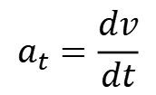
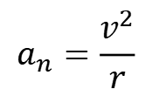

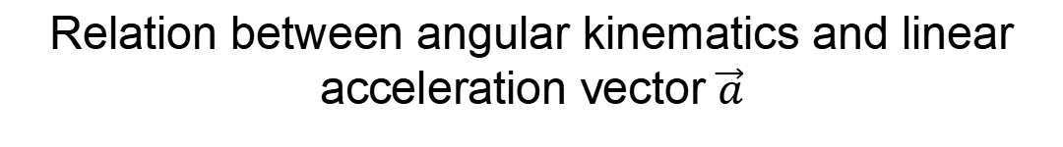
Relation between angular kinematics and linear acceleration vector $\vec{a}$
Linear acceleration vector $\vec{a}$ has two curvilinear components, which are for a circular motion:
$$\vec{v}$$
$$a_{t}$$
$$a_{t}=\frac{dv}{dt}$$
$$\vec{a}$$
$$P$$
Tangential component
$$a_{n}=\frac{v^{2}}{r}$$
$$a_{n}$$
$$O$$
Normal component
$$r$$
Notes:
PARLER LENTEMENT: Now, let’s see the relationship between the linear acceleration vector and the angular acceleration vector. I reminds you here the two components of the angular acceleration vector in curvilinear coordinates: the tangential component and the normal component. Take care that this acceleration vector could be not directed toward the center of the circle.

Slide 84


Relation between angular kinematics and linear acceleration vector $\vec{a}$
Linear acceleration vector $\vec{a}$ has two curvilinear components, which are for a circular motion:
$$\vec{v}$$
$$a_{t}$$
$$a_{t}=\frac{dv}{dt}$$
$$\vec{a}$$
$$P$$
Tangential component
$$a_{n}=\frac{v^{2}}{r}$$
$$a_{n}$$
$$O$$
Normal component
$$r$$
$$\frac{dv}{dt}=\frac{d\left(rω\right)}{dt}=r\frac{dω}{dt}$$
$$a_{t}=rα$$
Notes:
PARLER LENTEMENT: The change rate of the velocity v is the radius of circle multiplied by the change rate of the angular velocity, We obtain that the tangential acceleration is the radius of the circular motion multiplied by the magnitude acceleration vector. Take care that this tangential acceleration component is always positive or equals zero, for both clockwise or anticlockwise motion. It is never negative, because the magnitude of the acceleration vector is always positive.

Slide 85


Relation between angular kinematics and linear acceleration vector $\vec{a}$
Linear acceleration vector $\vec{a}$ has two curvilinear components, which are for a circular motion:
$$\vec{v}$$
$$a_{t}$$
$$a_{t}=\frac{dv}{dt}$$
$$\vec{a}$$
$$P$$
Tangential component
$$a_{n}=\frac{v^{2}}{r}$$
$$a_{n}$$
$$O$$
Normal component
$$r$$
$$\frac{dv}{dt}=\frac{d\left(rω\right)}{dt}=r\frac{dω}{dt}$$
$$a_{t}=rα$$
Important to remember (or to find by yourself)
$$v^{2}=r^{2}ω^{2}$$
$$a_{n}=rω^{2}$$
Notes:
PARLER LENTEMENT: The normal acceleration is the radius of the circular motion multiplied by the square of the magnitude of the angular velocity vector. These both expressions are important to remember, but you can find them by yourself easily if you know the expression of the tangential and normal acceleration.

Slide 86

Relation between angular kinematics and linear acceleration vector $\vec{a}$
Linear acceleration vector $\vec{a}$ has two curvilinear components, which are for a circular motion:
$$\vec{v}$$
$$a_{t}$$
$$a_{t}=\frac{dv}{dt}$$
$$\vec{a}$$
$$P$$
Tangential component
$$a_{n}=\frac{v^{2}}{r}$$
$$a_{n}$$
$$O$$
Normal component
$$r$$
$$\frac{dv}{dt}=\frac{d\left(rω\right)}{dt}=r\frac{dω}{dt}$$
$$a_{t}=rα$$
Important to remember (or to find by yourself)
$$v^{2}=r^{2}ω^{2}$$
$$a_{n}=rω^{2}$$
If the motion is uniform circular motion, $α=0$
$a_{t}=0$, $a=a_{n}=rω^{2}$
Notes:
PARLER LENTEMENT: For the particular case of the uniform circular motion, the tangential acceleration is zero, the acceleration vector is directed toward the center O of the circle and the acceleration has the expression of the normal component.

Slide 87

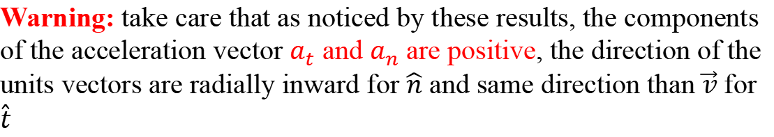

Relation between angular kinematics and linear acceleration vector $\vec{a}$
$$a_{t}=rα$$
$$\vec{v}$$
$$a_{t}$$
$$\hat{t}$$
$$a_{n}=rω^{2}$$
$$\vec{a}$$
$$P$$
$$\hat{n}$$
$$a_{n}$$
$$O$$
$$r$$
$α$ is the magnitude of angular acceleration vector $\vec{α}$
$ω$ is the magnitude of angular velocity vector $\vec{ω}$
Warning: take care that as noticed by these results, the components of the acceleration vector $a_{t}$ and $a_{n}$ are positive, the direction of the units vectors are radially inward for $\hat{n}$ and same direction than $\vec{v}$ for $\hat{t}$
Notes:
PARLER LENTEMENT: Here I just say to take care that the tangential and normal acceleration are always positive. The normal unit vector is radially inward, and the tangential unit vector has the same direction than the velocity vector.

Slide 88







About units
$$v=rω$$
unit:$m.s^{−1}$
$$unit:m$$
$$a_{t}=rα$$
unit:$m.s^{−2}$
$unit:$m
$$s=rθ$$
unit:$m$
$unit:$m
Question: what are units of $ω$ and $α$ ? (2 minutes)
Notes:
PARLER LENTEMENT: Now, let’s speak about the units. We consider for the velocity the SI units meter per second. For the radius of the circular motion the unit is the meter. For the tangential acceleration, the unit is meter per square second. Please to describe me for this case the unit of the omega and alpha.

Slide 89



About units
$$v=rω$$
unit: $rad.s^{−1}$
unit:$m.s^{−1}$
$$unit:m$$
$$a_{t}=rα$$
unit: $rad.s^{−2}$
unit:$m.s^{−2}$
$unit:$m
$$s=rθ$$
unit: $rad$
unit:$m$
$unit:$m
Notes:
PARLER LENTEMENT: We have to describe a unit for angle, and here the unit is the radian, symbol rad. So, for the angular displacement, its unit is the radian. The unit of the angular velocity is radians per second. The unit of angular acceleration is radians per square second,

Slide 90
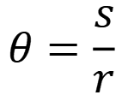
About units
$$r$$
$$s=rθ$$
$$\vec{v}$$
$$θ=\frac{s}{r}$$
$$θ$$
$$s=rθ$$
The angle $θ$ represent the ratio between $s$ and $r$ which must be expressed with the same unit.
Notes:
PARLER LENTEMENT: You can see here that the angle theta corresponds to the ratio between the curvilinear displacement s and the radius of the circle r. In that cases, the unit of the path s and the radius r should have the same unit, the SI unit meter for instance. If they have the same unit, the unit of angle theta is the radian.

Slide 91
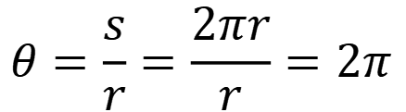
About units
$$r$$
$$s=rθ$$
$$\vec{v}$$
$$θ=\frac{s}{r}$$
$$θ$$
$$s=rθ$$
The angle $θ$ represent the ratio between $s$ and $r$ which must be expressed with the same unit.
$$θ=\frac{s}{r}=\frac{2πr}{r}=2π$$
If the motion describes a full circle
rad
Notes:
PARLER LENTEMENT: For instance if the motion describe a full circle, the displacement s correspond to 2pi multipled by r , which is the circumference of the circle. Thus, the angle theta is equal to 2pi radians,

Slide 92
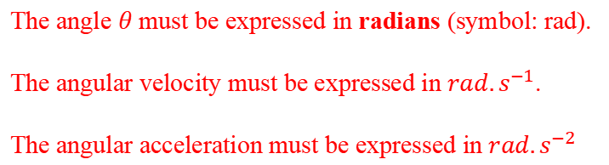
About units
$$r$$
$$s=rθ$$
$$\vec{v}$$
$$θ=\frac{s}{r}$$
$$θ$$
$$s=rθ$$
The angle $θ$ represent the ratio between $s$ and $r$ which must be expressed with the same unit.
$$θ=\frac{s}{r}=\frac{2πr}{r}=2π$$
If the motion describes a full circle
rad
The angle $θ$ must be expressed in radians (symbol: rad).
The angular velocity must be expressed in $rad.s^{−1}$.
The angular acceleration must be expressed in $rad.s^{−2}$
Notes:
PARLER LENTEMENT: Because the angle theta is described in rad, the angular velocity is described in radians per second. And the angular acceleration is described in radians per square second.

Slide 93
Rest time (5 minutes)

Slide 94
2. The moment of inertia 转动惯量/惯性矩
Notes:
PARLER LENTEMENT: Now, let’s describe the moment of inertia of a body.

Slide 95




Introduction
We divide the body in particles of mass $m_{i}$
$$\vec{v_{i}}$$
$$r_{i}$$
$$m_{i}$$
We consider a rigid body in rotation (at angular velocity $ω$). A particle at distance $r_{i}$ from the axis of rotation has velocity vector ${\vec{v}}_{i}$ and mass $m_{i}.$
Notes:
PARLER LENTEMENT: We consider a rigid body in rotation, as this wheel, at a certain angular velocity omega. We divide this body in particles of mass m_i. These particles has velocity vector vi and are at distance r_i from the axis of rotation,

Slide 96

Introduction
We divide the body in particles of mass $m_{i}$
$$\vec{v_{i}}$$
$$r_{i}$$
$$m_{i}$$
We consider a rigid body in rotation (at angular velocity $ω$). A particle at distance $r_{i}$ from the axis of rotation has velocity vector ${\vec{v}}_{i}$ and mass $m_{i}.$
$$E_{K,i}=\frac{1}{2}m_{i}{v_{i}}^{2}=\frac{1}{2}m_{i}{r_{i}}^{2}ω^{2}$$
Its kinetic energy is :
Notes:
PARLER LENTEMENT: We can describe the kinetic energy of each particle in terns of the velocity of the particle, but also in terms of the r_i and the angular velocity of the rotational motion.

Slide 97

Introduction
We divide the body in particles of mass $m_{i}$
$$\vec{v_{i}}$$
$$r_{i}$$
$$m_{i}$$
We consider a rigid body in rotation (at angular velocity $ω$). A particle at distance $r_{i}$ from the axis of rotation has velocity vector ${\vec{v}}_{i}$ and mass $m_{i}.$
$$E_{K,i}=\frac{1}{2}m_{i}{v_{i}}^{2}=\frac{1}{2}m_{i}{r_{i}}^{2}ω^{2}$$
Its kinetic energy is :
The total kinetic energy of the body of N particles is:
$$E_{K}=\sum_{i}{E_{K,i}}$$
Notes:
PARLER LENTEMENT: And the total kinetic energy of the system of the N particles is the sum of their kinetic energy,

Slide 98

Introduction
The total kinetic energy of the body of N particles is:
$$E_{K}=\sum_{i}{E_{K,i}}$$
$$\vec{v_{i}}$$
$$r_{i}$$
$$m_{i}$$
$$E_{K}=\sum_{i}{\frac{1}{2}m_{i}{r_{i}}^{2}ω^{2} }$$
Notes:
PARLER LENTEMENT: We obtain the following expression of the total kinetic energy of the system of N particles. You can see that the angular velocity is the same for all the particles, we can put it outside the sum.

Slide 99

Introduction
The total kinetic energy of the body of N particles is:
$$E_{K}=\sum_{i}{E_{K,i}}$$
$$\vec{v_{i}}$$
$$r_{i}$$
$$m_{i}$$
$$E_{K}=\sum_{i}{\frac{1}{2}m_{i}{r_{i}}^{2}ω^{2} }$$
$$E_{K}=\frac{1}{2}\left(\sum_{i}{m_{i}{r_{i}}^{2} }\right)ω^{2}$$
Notes:
PARLER LENTEMENT: We obtain the corresponding expression. The total kinetic energy is the half of something multiplied by the square of the angular velocity.

Slide 100


Introduction
The total kinetic energy of the body of N particles is:
$$E_{K}=\sum_{i}{E_{K,i}}$$
$$\vec{v_{i}}$$
$$r_{i}$$
$$m_{i}$$
$$E_{K}=\sum_{i}{\frac{1}{2}m_{i}{r_{i}}^{2}ω^{2} }$$
$$E_{K}=\frac{1}{2}\left(\sum_{i}{m_{i}{r_{i}}^{2} }\right)ω^{2}$$
The moment of inertia of a system of N particles is described by:
$I=\sum_{i=1}^{N}{m_{i}{r_{i}}^{2}}$转动惯量
Notes:
PARLER LENTEMENT : Which is what we call the moment of inertia of a system of N particles. Of course, a rigid body is not strictly a system of particles, which is an idealized model and later we will see how to describe the moment of inertia of any body in rotational motion.

Slide 101
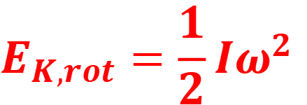
Rotational kinetic energy and moment of inertia
A body in rotation as a rotational kinetic energy:
$$E_{K,rot}=\frac{1}{2}Iω^{2}$$
angular velocity
Moment of inertia of the body in rotation
Rotational kinetic energy
(the subscript “rot” could be omitted, but we will see later why we add it here)
Notes:
PARLER LENTEMENT: But the total kinetic energy we have described can be seen described for any body in rotational motion. So, here is the expression of the rotational kinetic energy of a body in rotational motion. It is the half of the moment of inertia of the body multiplied by the square of the angular velocity.

Slide 102
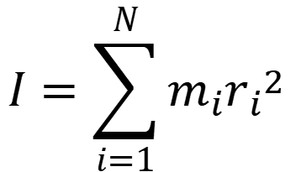





The moment of inertia
If the body is composed by N particles of mass $m_{i}$, the moment of inertial of the body in rotational motion is:
$$I=\sum_{i=1}^{N}{m_{i}{r_{i}}^{2}}$$
$$r_{i}:distance from axis of rotation$$
Example:
With two particles
Axis of rotation
$$I=m_{1}{r_{1}}^{2}+m_{2}{r_{2}}^{2}$$
$$r_{1}$$
$$r_{2}$$
$$m_{1}$$
$$m_{2}$$
Notes:
PARLER LENTEMENT: Now let’s describe more details about the moment of inertia of a system. Take care that the moment of inertia depends to which axis of rotation you consider because its expression include the distance between the particles and the axis of rotation. For instance, here is an example with two particles. The moment of inertia of the system is the sum of the moment of inertia of each particles where r_1 and r_2 is the distance between the particles and the axis of rotation. I have chosen this axis but I could have chosen another axis.

Slide 103
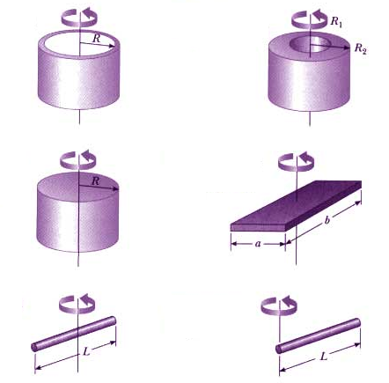
The moment of inertia
However, a particle is an idealized point-like body associated to a mass.
How to describe the moment of inertia of real bodies, which are not point-like or a sum of point-like particles ?
Examples of bodies in rotation
Notes:
PARLER LENTEMENT: Can we use the previous expression to describe the moment of inertia for any rigid body ? A particle is an idealized point-like body. If a body can be described as a sum of point-like bodies, we could use the previous expression. But in the examples of body of rotation I show you here, we cannot strictly describe these bodies as a collection of particles.

Slide 104
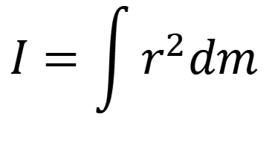
The moment of inertia
$$I=\int{r^{2}dm}$$
body
Infinitesimal mass in the body
distance from the axis of rotation
Notes:
PARLER LENTEMENT: Here is the expression to describe the moment of inertia of any rigid body, it is similar with the previous expression but in an integral form. It is the integral sum of the infinitesimal mass dm in the body of the square of the distance from the axis of rotation. I don’t give the bounds of the integrals, because these bounds depends on the shape of the body.

Slide 105

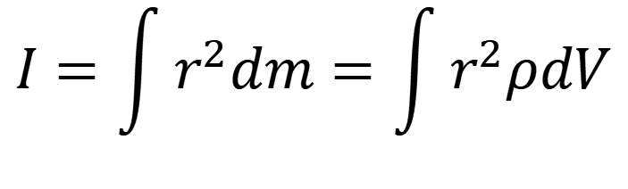
The moment of inertia
$$I=\int{r^{2}dm}=\int{r^{2}ρdV}$$
body
body
Infinitesimal mass in the body
$$dm=ρdV$$
distance from the axis of rotation
where $ρ$ is the local mass density (SI unit: $kg.m^{−3}$), $dV$ is an infinitesimal volume in the body
Notes:
PARLER LENTEMENT: We can express an infinitesimal mass as the product between the local mass density in the body and the infinitesimal volume dV. Take care that this local mass density could be not uniform, however in most of cases we will consider it as uniform and in that case we can put it outside the integral.

Slide 106
The moment of inertia
$$I=\int{r^{2}dm}=\int{r^{2}ρdV}$$
Important to remember
body
body
Infinitesimal mass in the body
$$dm=ρdV$$
distance from the axis of rotation
where $ρ$ is the local mass density (SI unit: $kg.m^{−3}$), $dV$ is an infinitesimal volume in the body
Warning: take care that the mass density of the body could be not uniform ! But for us, we will consider in most of cases that it is uniform.
Notes:
PARLER LENTEMENT: Also please to remember this expression of the moment of inertia of rigid body.

Slide 107
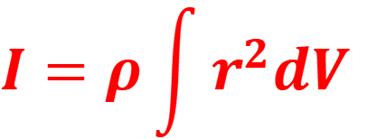
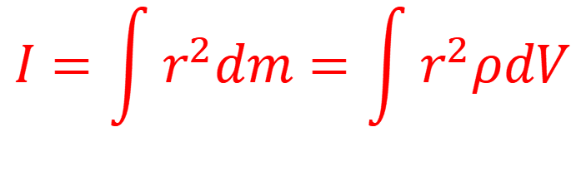
The moment of inertia
$$I=\int{r^{2}dm}=\int{r^{2}ρdV}$$
Important to remember
body
body
For a body with uniform mass density $ρ$:
$$I=ρ\int{r^{2}dV}$$
body
Notes:
PARLER LENTEMENT: And for the cases where the mass density in the body is uniform, the expression of the moment of inertia become as follows.

Slide 108

A word about integral calculation
Imagine we want to use integral calculation to describe the surface of a disk
$$R$$
Disk of surface S=?
Notes:
PARLER LENTEMENT: Before to give you the solution, I will speak you briefly about integral calculation. Imagine a disk which you want to describe the surface or integral over its surface and you have to describe an infinitesimal surface in this disk. The kind of the infinitesimal surface depends to which shape you are studying, here, a disk.

Slide 109
A word about integral calculation
Imagine we want to use integral calculation to describe the surface of a disk
$$R$$
Disk of surface S=?
The choice of the infinitesimal surface $dS$ within the disk depends to the shape considered.
Rectangular infinitesimal surface dS
A ring-shaped infinitesimal surface dS
Notes:
PARLER LENTEMENT: Here you see two possible choices of infinitesimal surfaces, but one is a wrong choice and the other one is the right choice. If you choose the rectangular infinitesimal surface, it will be not possible for you to do the integral calculation of the whole disk. So, you have to choose another kind of infinitesimal surface, as a ring-shaped infinitesimal surface. Of course, the infinitesimal volume you choose depends also on which shape of the volume you have to consider.

Slide 110
A word about integral calculation
Imagine we want to use integral calculation to describe the surface of a disk
$$R$$
Disk of surface S=?
The choice of the infinitesimal surface $dS$ within the disk depends to the shape considered.
Rectangular infinitesimal surface dS
A ring-shaped infinitesimal surface dS
A wrong choice !
A right choice !
Notes:
PARLER LENTEMENT: So, the choice of a ring-shaped infinitesimal surface is a right choice and here the choice of a rectangular infinitesimal surface is not a right choice.

Slide 111



A word about integral calculation
Imagine we want to use integral calculation to describe the surface of a disk
$$dS$$
$$R$$
$$r$$
$$dr$$
Disk of surface S=?
The infinitesimal surface is here the ring between the circle of radius $r$and the circle of radius $r+dr$, i.e.
$$dS=2πrdr$$
Notes:
PARLER LENTEMENT: Now, let’s describe the infinitesimal surface. You can see that it is the product between the circumference of the ring 2pi r, multiplied by the infinitesimal change of radius dr. This is because the infinitesimal surface is between the circles of radius r and r+ dr.

Slide 112
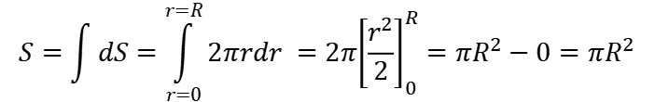
A word about integral calculation
Imagine we want to use integral calculation to describe the surface of a disk
$$dS$$
$$R$$
$$r$$
$$dr$$
Disk of surface S=?
$$S=\int{dS}=\int_{r=0}^{r=R}{2πrdr }=2π{\left[\frac{r^{2}}{2}\right]}_{0}^{R}=πR^{2}−0=πR^{2}$$
Notes:
PARLER LENTEMENT: Then we do the integral calculation. Here I give you all the steps of the calculation. It is not an obligation of course, but it permit to avoid mistakes. In the brackets here, is written the anti-derivative of the function to integrate. 2 pi is putted outside the integral because it is a constant value. We obtain that the surface of the disk is pi multiplied by the square of its radius.

Slide 113
End of lecture 7

